Slide 1
On Our Way to a World Larger Than Ourselves
On the Relation Between Economic Development
and Good Governance in a Sustainable Society
Inaugural professorial lecture as
Professor of Global Economy & Governance
Philip E. Wagner

Slide 2
“The economy is important,
but there are more important
issues than the economy.”

Slide 3
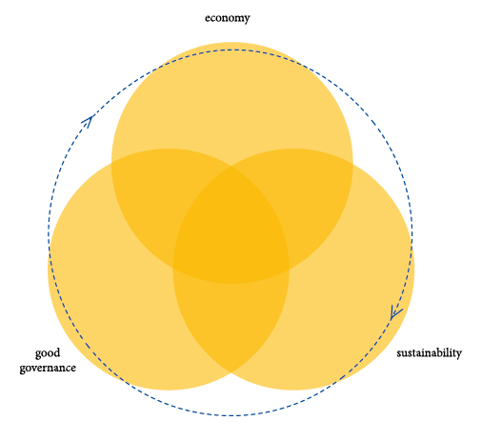
Economy, good governance and sustainability

Slide 4
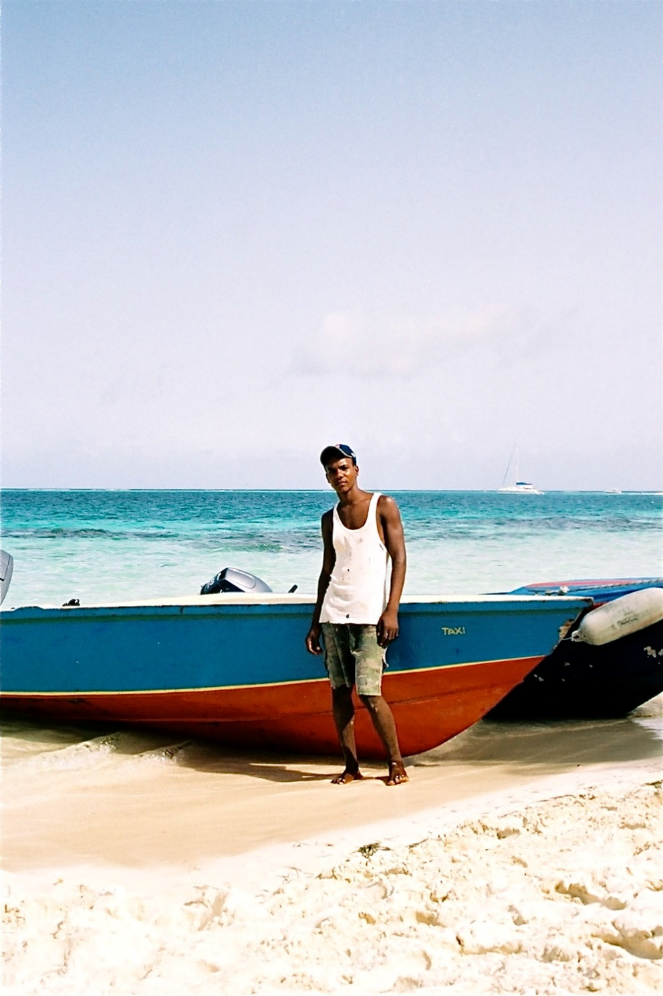
Dimensions in corporate social responsibility
Efficiency What will it yield?
Equity How are the pro’s and con’s divided?
Legitimacy Acceptability to indirectly concerned parties?
Sustainability For how long can we keep it up?
Purpose Does it fit our intrinsic motivation?

Slide 5
The core questions
What role do ‘ethics’ and ‘morals’ play in the transformation from ‘governance’ to ‘good governance’?
How can economic development and good governance reinforce each other as disciplines that connect the streets, the university and values as self-worth, self-regulation and respect to each other?
What can ICUC contribute in the development of knowledge useful in entrepreneurship, good governance and the development of a sustainable society?
What will be its contribution from the chair of Global Economy and Governance?
•
•
•
•

Slide 6
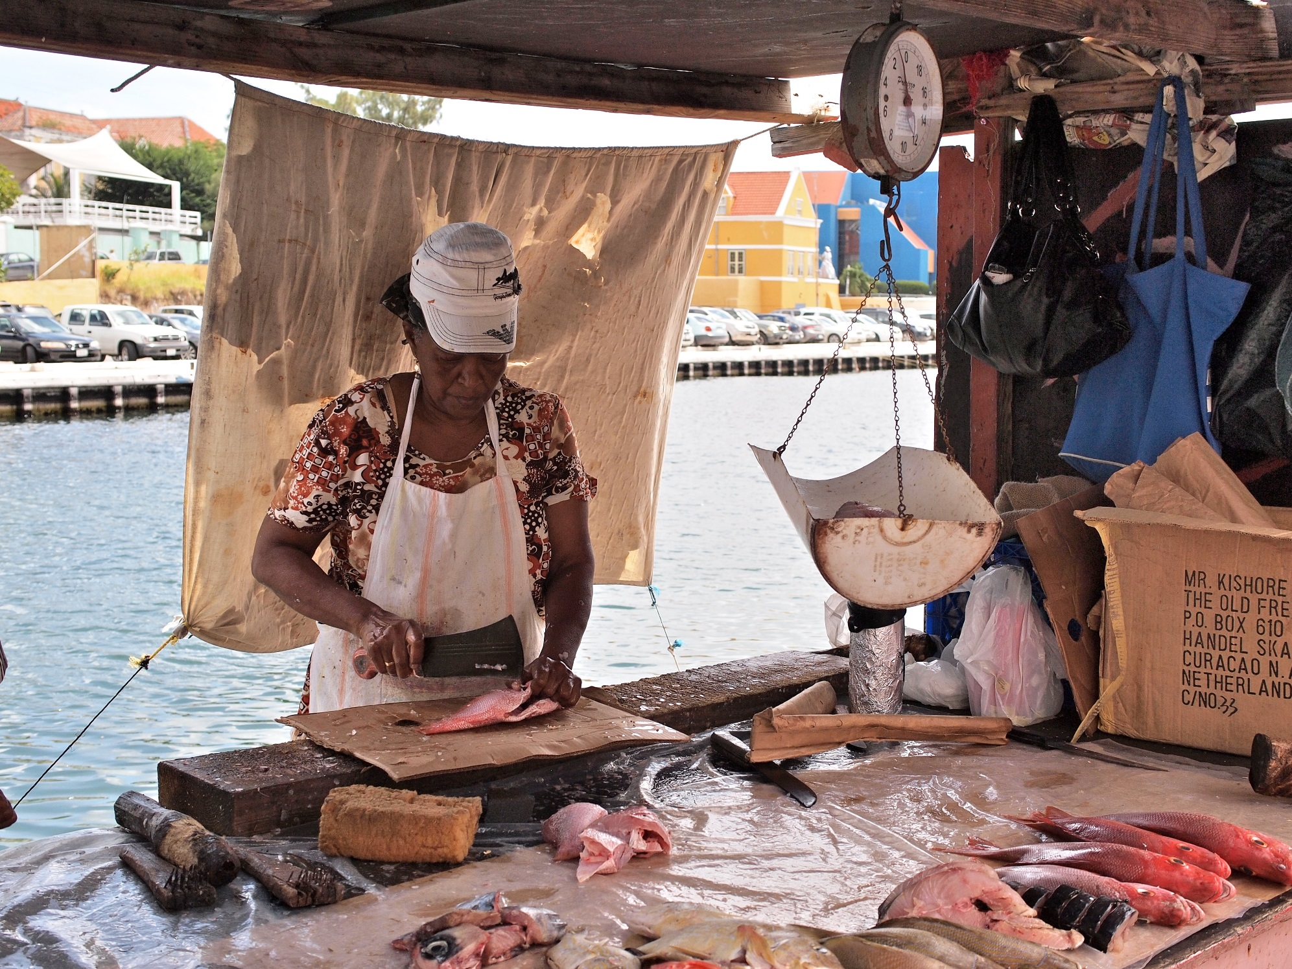
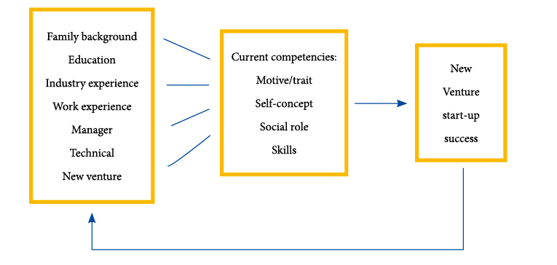
The ‘ecosystem’ surrounding entrepreneurship

Slide 7
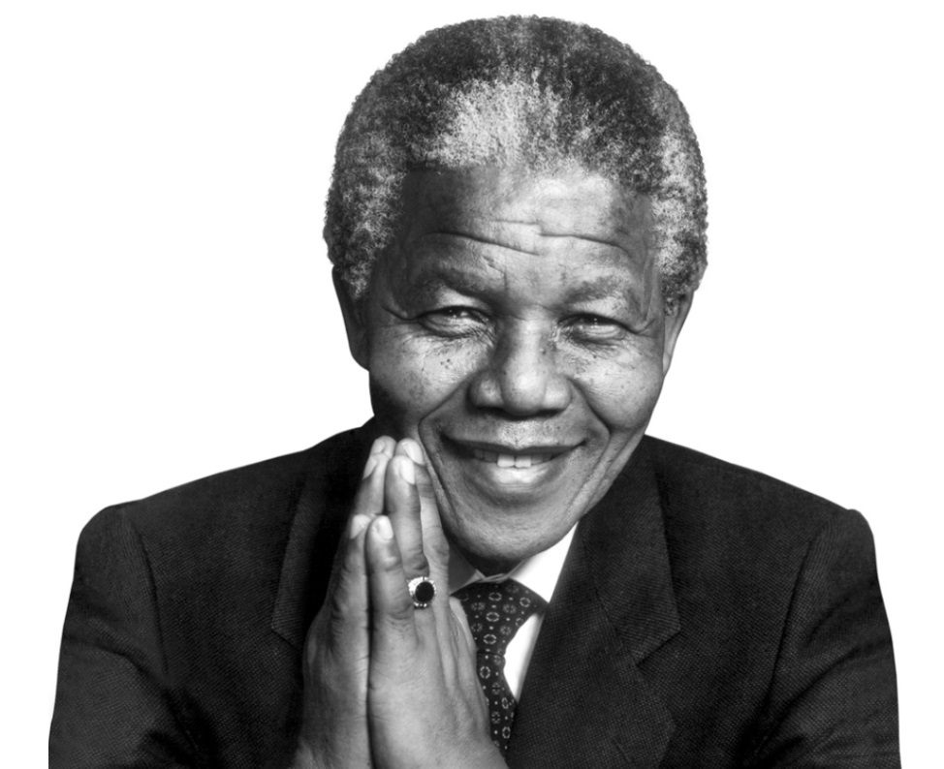
^{“Education is the}
^{most powerful weapon}
^{which you can use}
^{to change the world.”}

Slide 8
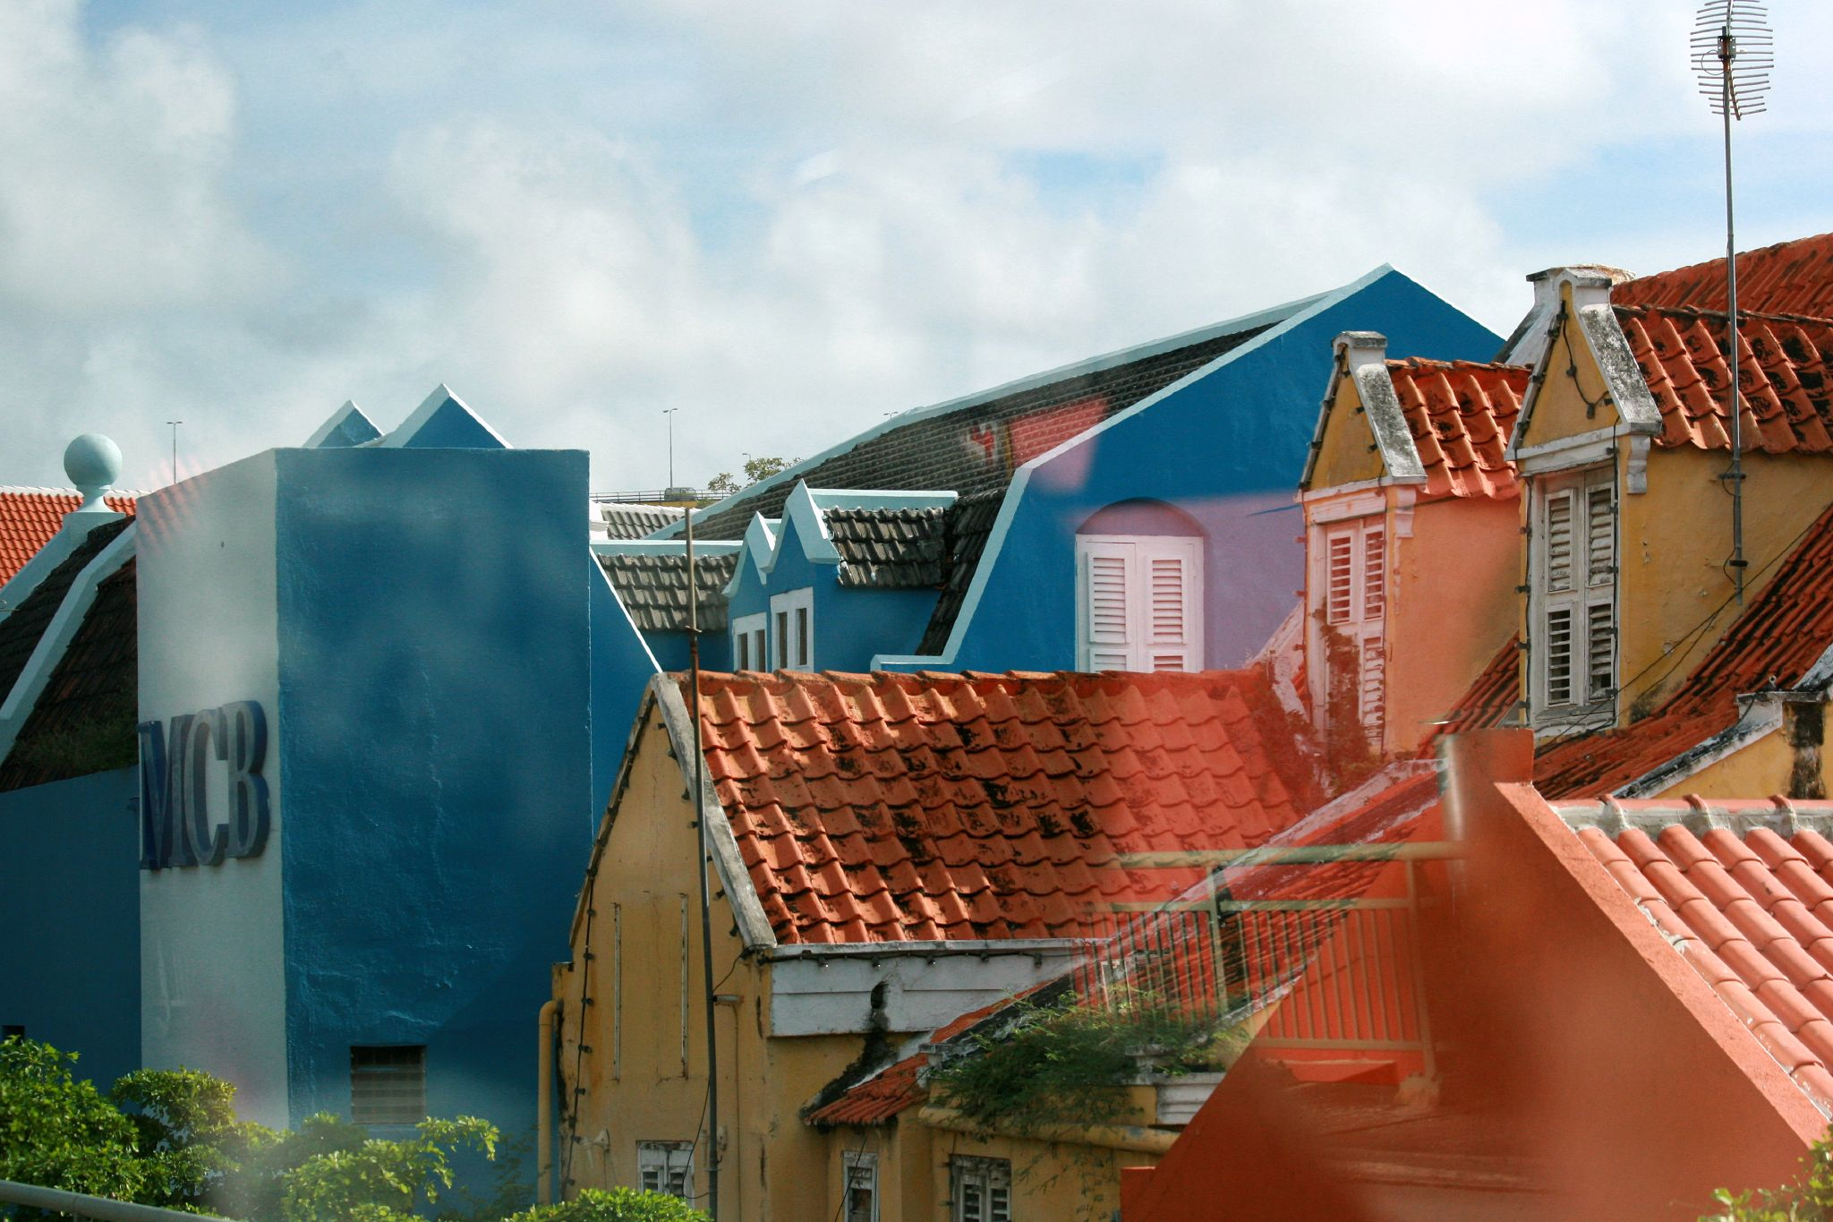
Multiple meanings of the term governance
The Anglo-Saxon model, characterized as a conflict model: facts and opinions are made explicit.
The Rhineland model, characterized as the consensus model: common values are accentuated.
The Asian model, characterized as the familiar model: the collective consciousness/self-awareness is displayed

Slide 9
Operating strategically
in the network economy

Slide 10
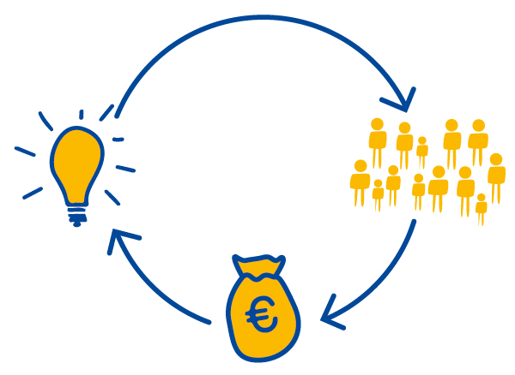
Transforming from a ‘perfect’ market to a modern institutional economy

Slide 11
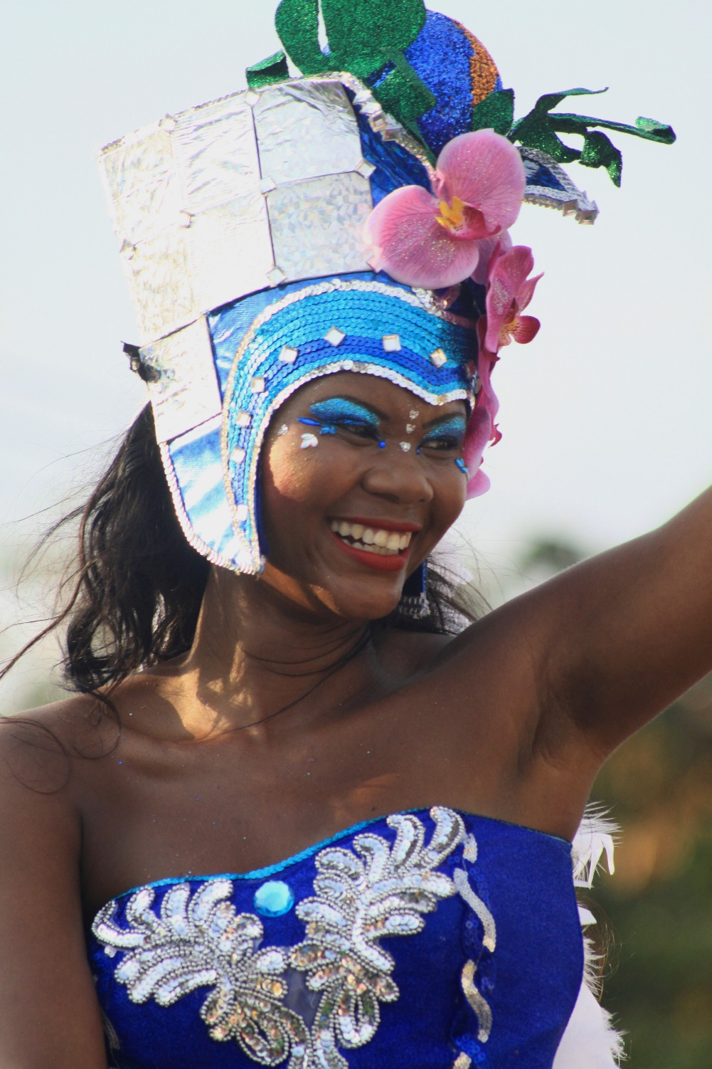
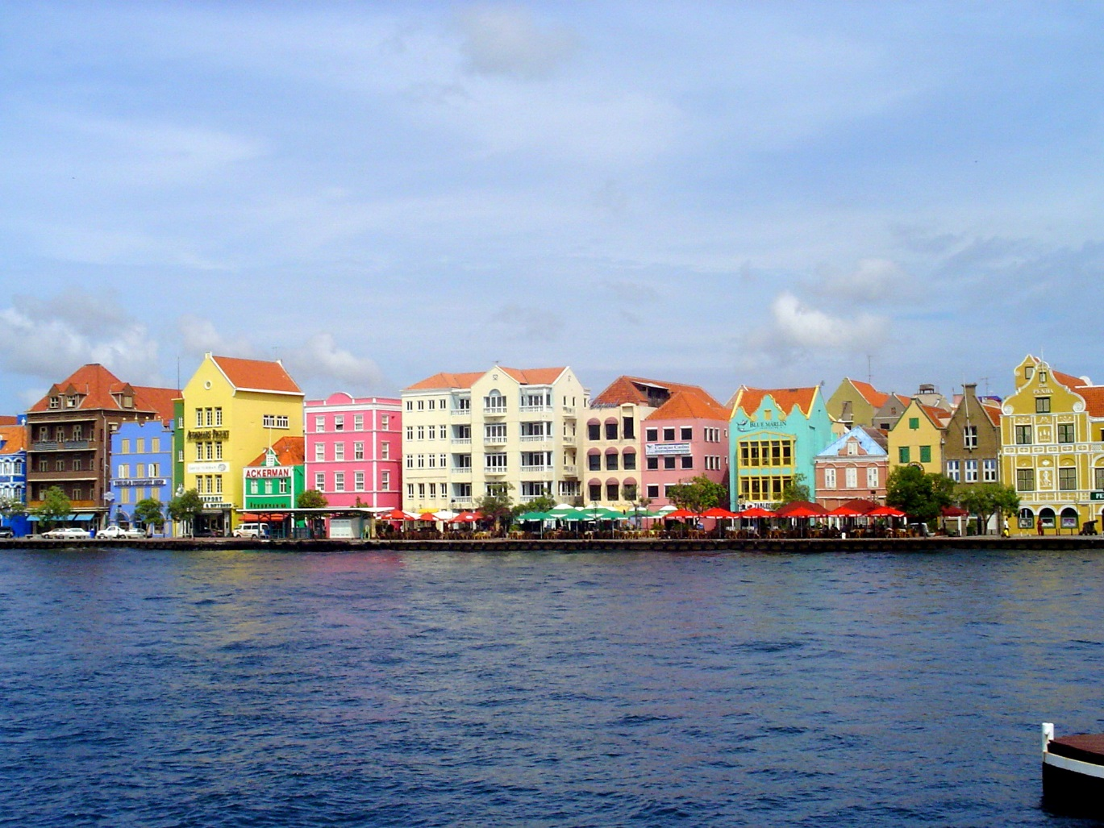
Curacao and her prospects
¸

Slide 12
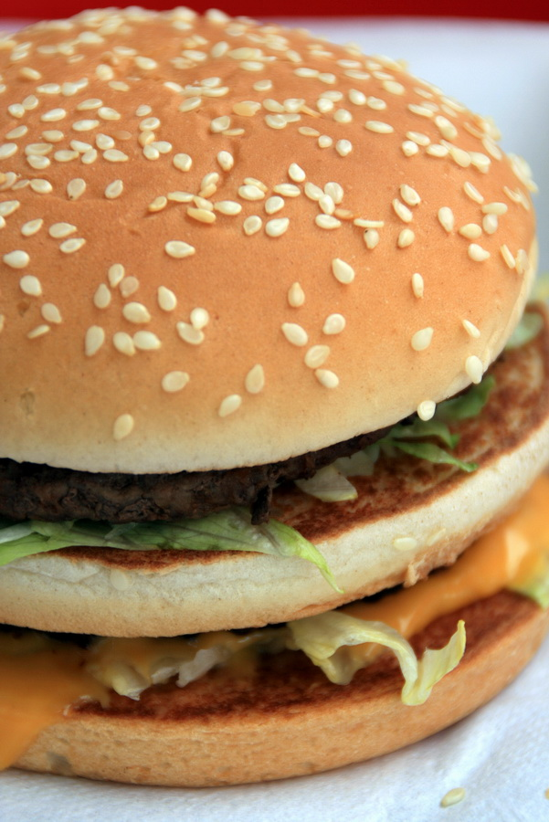
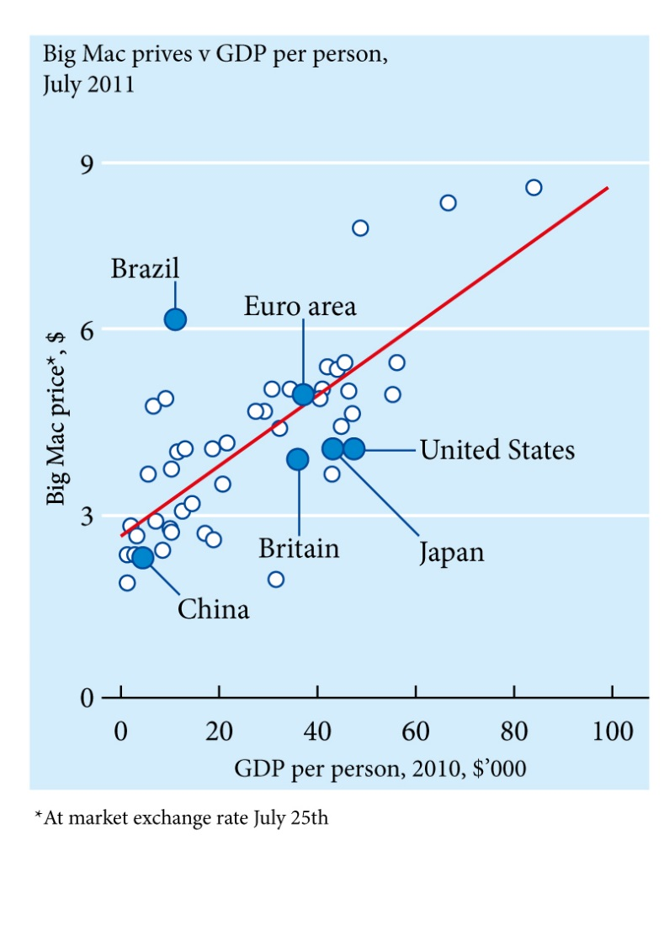
Access to Prosperity

Slide 13
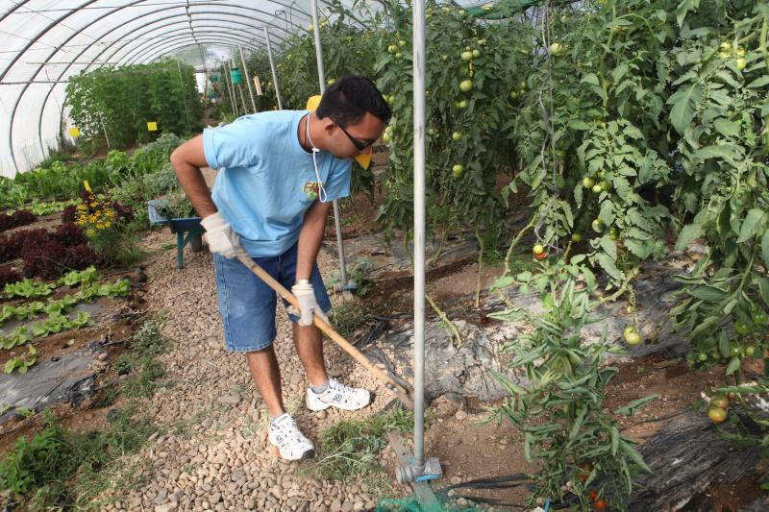
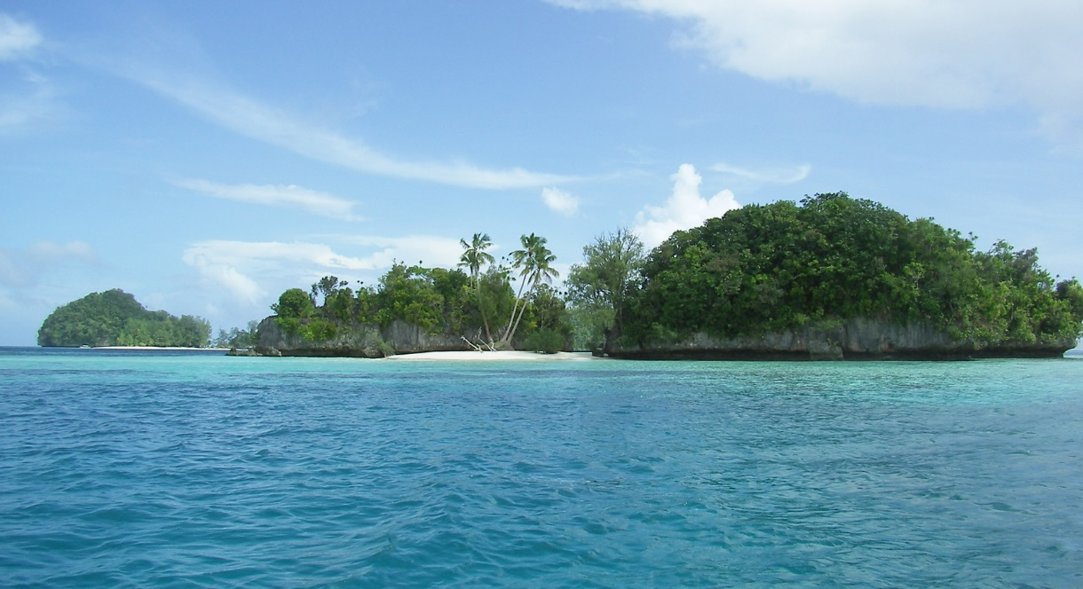
Evolving from a grey economy, by a green economy towards a blue economy

Slide 14
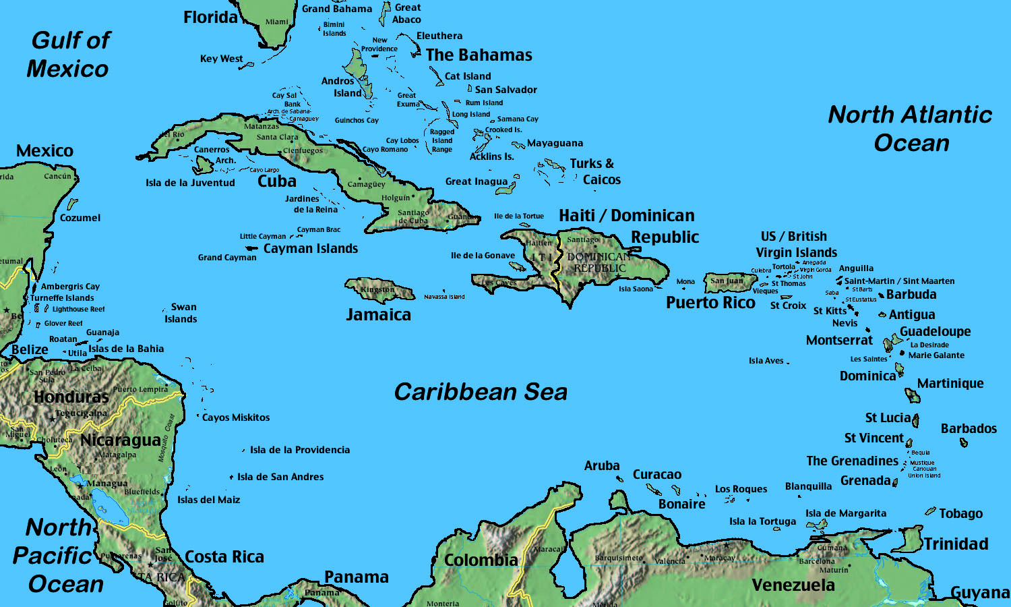
A Contemporary University
• Thought leadership
• Academic entrepreneurship

Slide 15
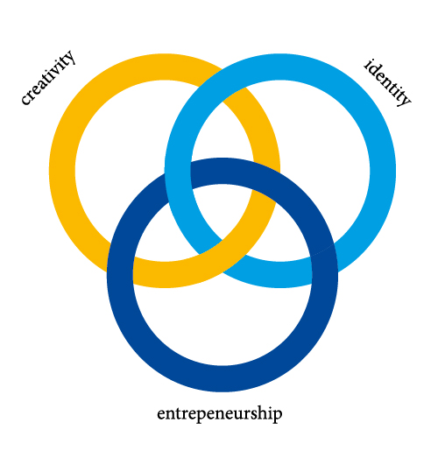
Education and research
• The foundation for good education is respect.
• Initiated research will depart from social issues:
- New Business Lab
- Diversity in Governance

Slide 16
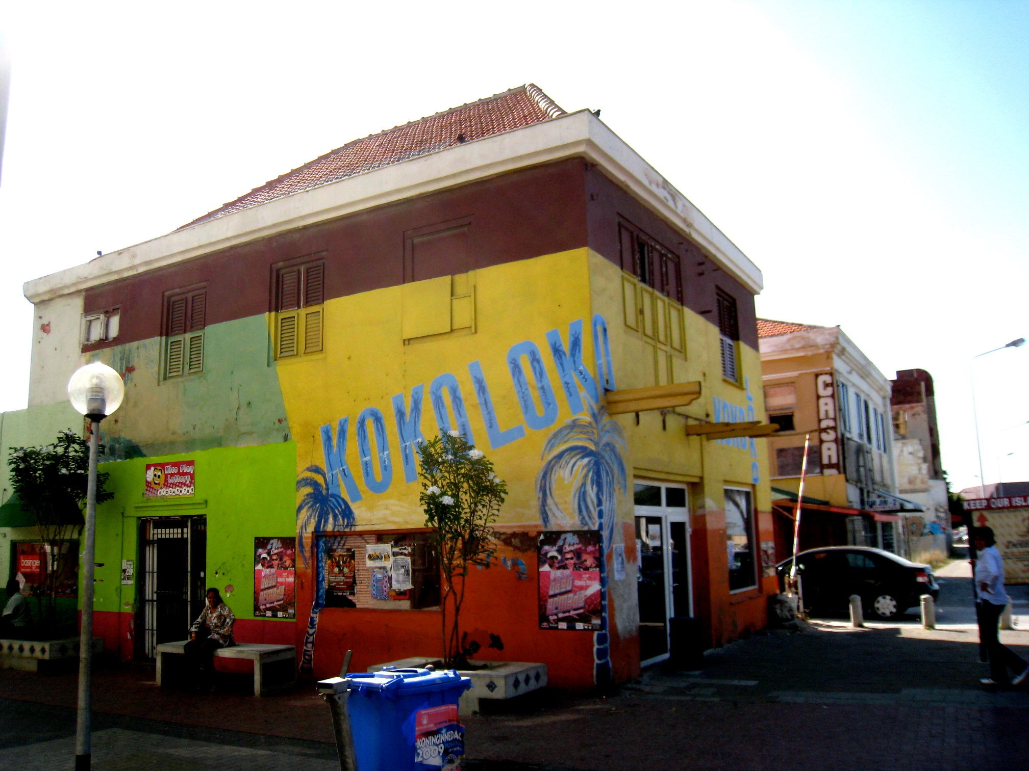
Caribbean Governance

Slide 17
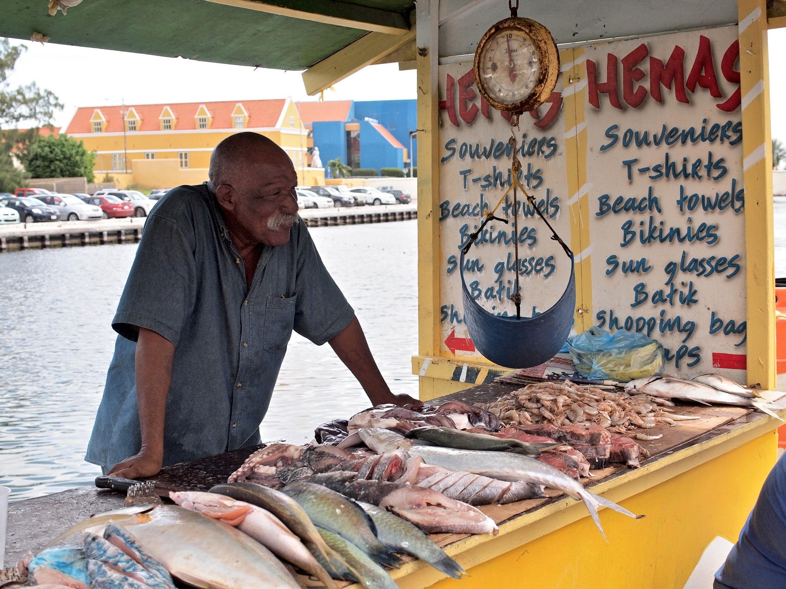
Going beyond borders

Slide 18
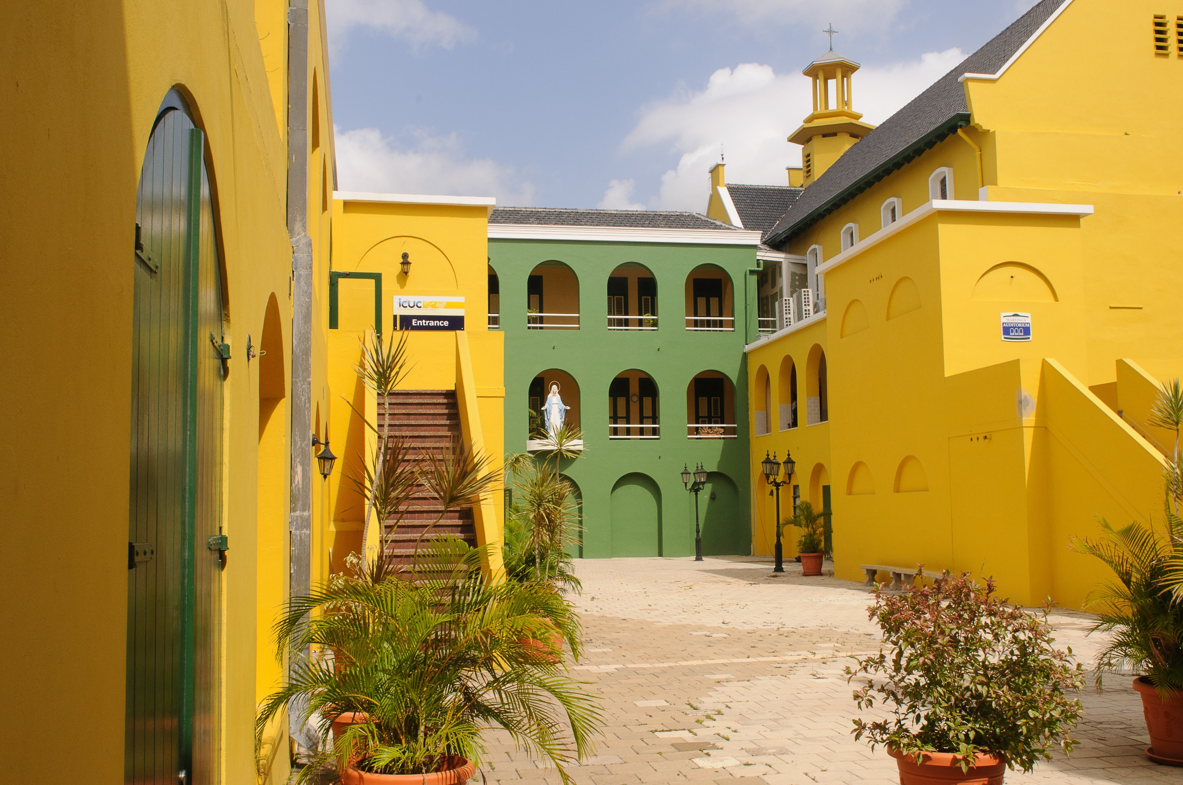
I Thank
Adri Broeke, Antje Diertens, Monique Krozendijk, Jolinda Louwerse, Steven Smit, Caro Turlings, Jan Vaessen
and Lolle Wijnja
for their help in the realization of this inaugural address.

